Slide 1
Mars Fault Detection using SAM
Progress Report
2025.8.
Ruobing Guo, Yuan Jiang

Slide 2
1. Getting Started

Slide 3
1.1 Setup
*WSL + Ubuntu Subsystem
Anaconda
Python
*VS Code
CUDA Toolkit
Create & activate Virtual Environment
PyTorch
Install SAM-2
Download SAM 2.1 checkpoints

Slide 4


1.2 Image Prediction Example
Automatic Mask Generation: https://github.com/facebookresearch/sam2/blob/main/notebooks/automatic_mask_generator_example.ipynb
Point/Box Prediction: https://github.com/facebookresearch/sam2/blob/main/notebooks/image_predictor_example.ipynb

Slide 5
2. Mars Data Overview

Slide 6
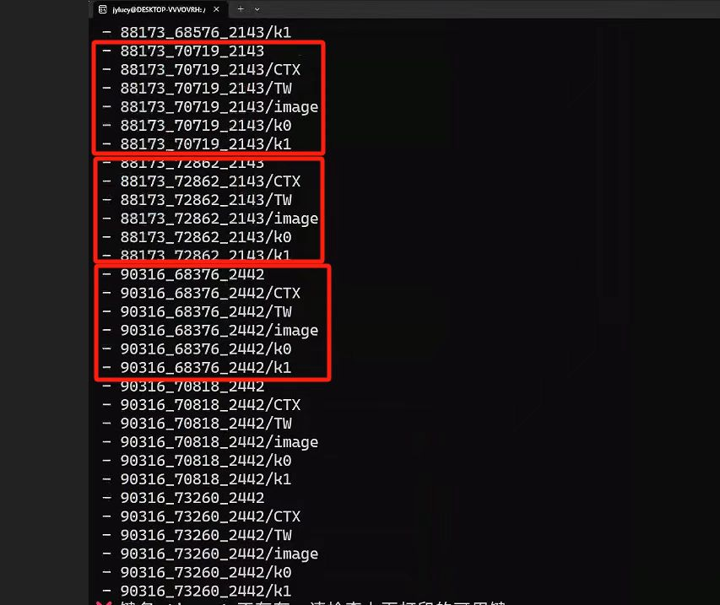
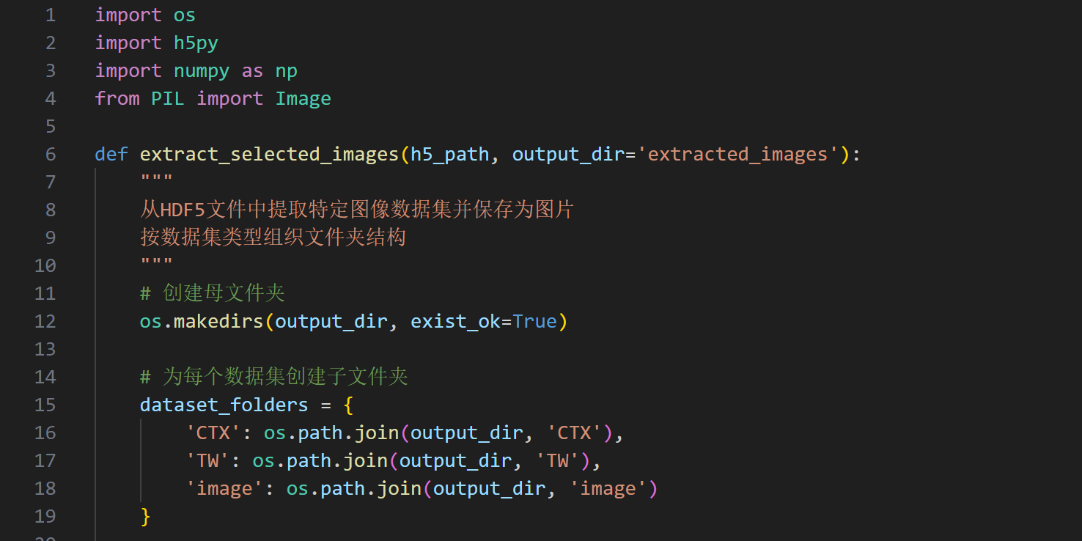
2.1 Dataset Contents
Files | Contents
/CTX | CTX images（Context Camera,High resolution image）
/TW | Image of Tianwen 1
/image | MOLA images（Mars Orbiter Laser Altimeter）
/k0 | The angular distance from each pixel to the nearest normal fault（°）
/k1 | The angular distance from each pixel to the nearest reverse fault（°）

Slide 7
File Naming Convention
  Example filename: 14759_70050_2335
  14759：Starting horizontal index (possibly longitude)
  70050：Starting vertical index (possibly latitude)
  2335：Original image size (likely resolution in pixels)
k0 / k1 Files：
  k0: Angular distance (in degrees) to the nearest normal fault
  k1: Angular distance to the nearest reverse fault
  Distance normalized by Mars’s equatorial degrees per latitude
  Values beyond 0.35° are set to 999 (indicating “no nearby fault”)

Slide 8
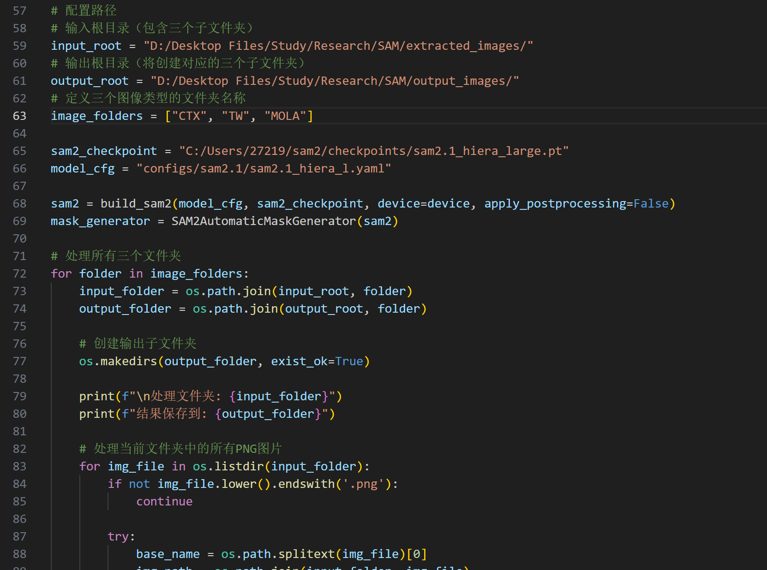
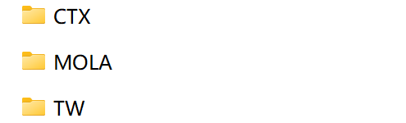
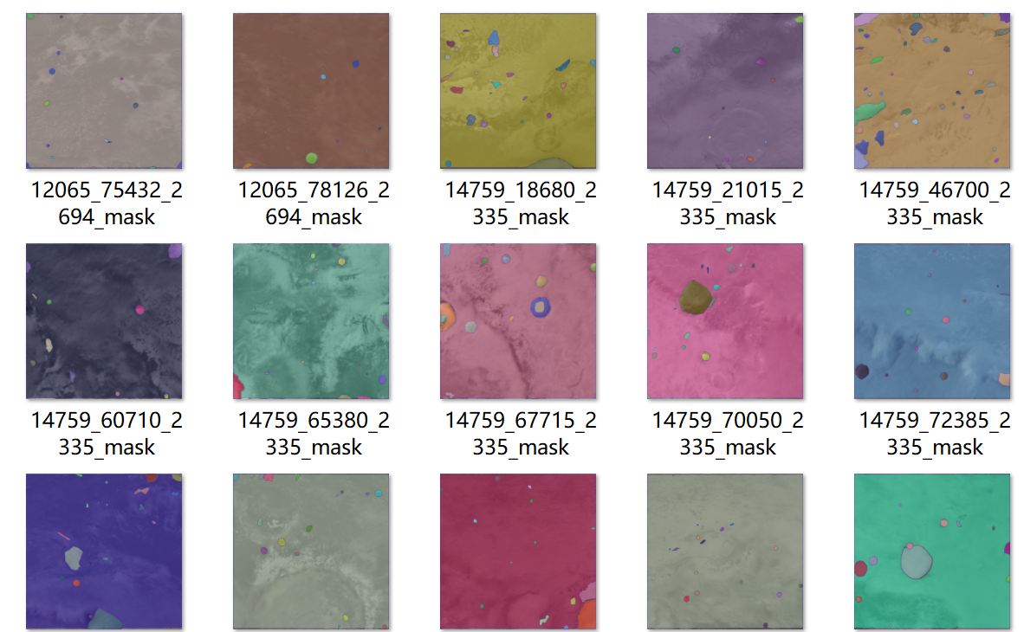
2.2 Script Fine-Tuning: Batch Processing
Output：

Slide 9
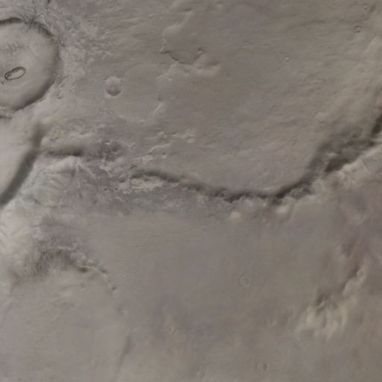
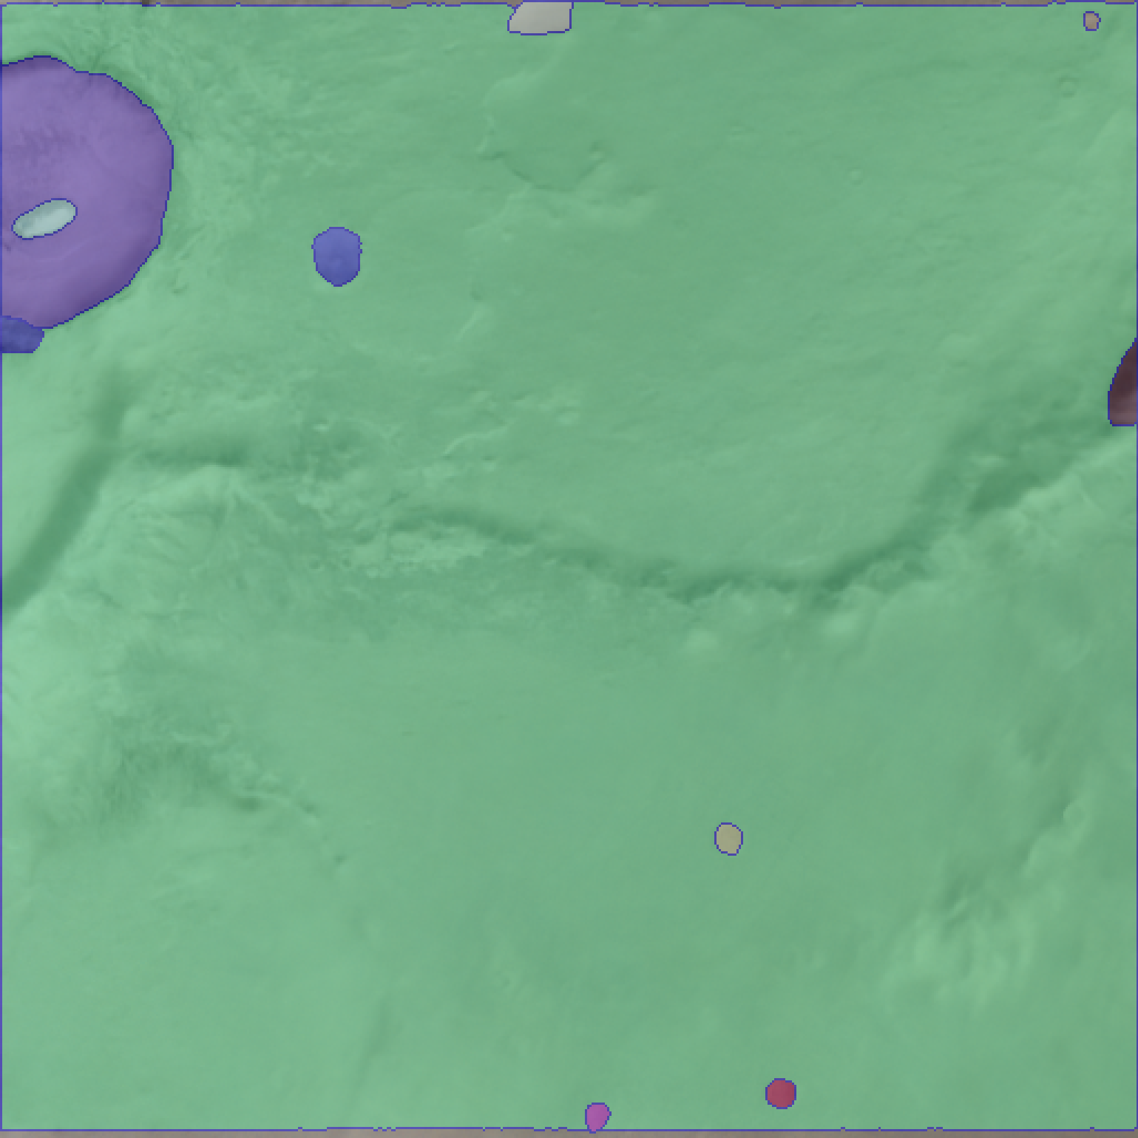
Output results and analysis
The SAM analysis results are unstable ：
  The color change of the surface image of Mars is not significant. In some areas with relatively blurred edges and scattered feature color blocks, the recognition accuracy of SAM is not high.
  SAM has great difficulty distinguishing faults from other landforms (such as craters).

